Slide 1

Minimum Cost to Connect Two Groups of Points
This presentation explores a classic problem in computer science - finding the minimum cost to connect two groups of points. We'll discuss the problem, explore various solution approaches, and analyze the time and space complexity of these approaches. We'll then consider future scope and conclude with a summary of key takeaways.
DONE BY
ROSHAN JEYA PRAKASH

Slide 2

Introduction
1
Problem Statement
2
Applications
Given two sets of points, find the minimum cost to connect all points in one set to all points in the other set.
This problem has numerous applications in fields like network routing, facility location, and resource allocation.
3
Constraints
4
Goal
We must consider constraints such as distance, cost, and the number of connections.
Our goal is to find the most efficient and cost-effective way to connect these two sets of points.

Slide 3

Abstract
Minimum Spanning Tree (MST)
Graph Representation
We represent the points as nodes in a graph, with edges connecting them, with edge weights representing the cost of connecting two points.
The problem can be solved using the concept of Minimum Spanning Tree, which finds the least cost way to connect all vertices in a graph.
Algorithms
Algorithms like Kruskal's algorithm and Prim's algorithm can be used to efficiently find the minimum spanning tree.

Slide 4
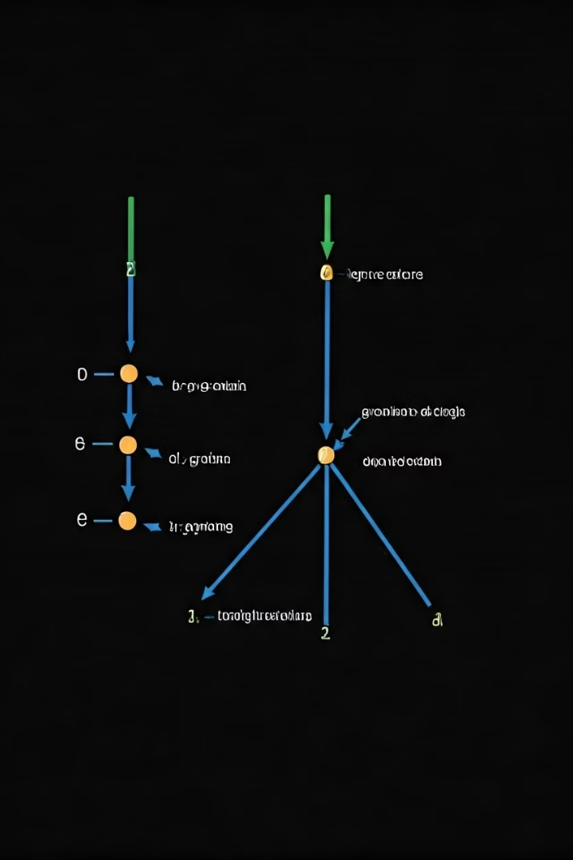
Solution Approach
1
Step 1: Graph Construction
Construct a graph representing the points, where edges represent the cost of connecting points.
2
Step 2: MST Algorithm
Apply Kruskal's algorithm or Prim's algorithm to find the minimum spanning tree of the graph.
3
Step 3: Cost Calculation
Calculate the total cost of the edges in the minimum spanning tree, which represents the minimum cost to connect the points.

Slide 5
Coding
Python
Java
```python def minimum_cost(points1, points2): # Construct graph graph = ... # Apply Kruskal's algorithm mst = kruskal(graph) # Calculate total cost total_cost = sum(edge[2] for edge in mst) return total_cost ```
```java public static int minimumCost(Point[] points1, Point[] points2) { // Construct graph Graph graph = ... // Apply Kruskal's algorithm List mst = kruskal(graph); // Calculate total cost int totalCost = 0; for (Edge edge : mst) { totalCost += edge.weight; } return totalCost; } ```

Slide 6
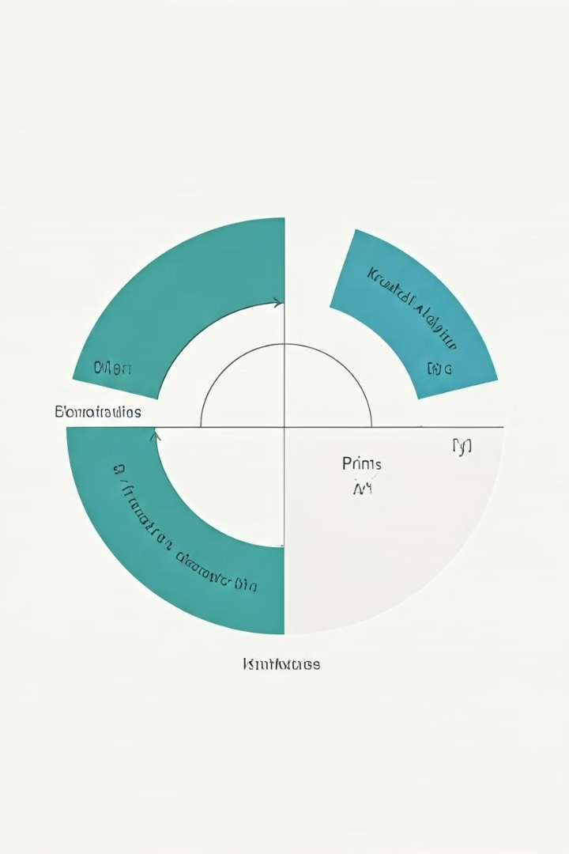
Complexity Analysis
Algorithm
Time Complexity
Space Complexity
Kruskal's Algorithm
O(E log E)
O(E + V)
Prim's Algorithm
O(E log V)
O(V + E)

Slide 7




Space Complexity
Graph Representation
Space used to store the graph, including vertices and edges.
Edge Lists
Space used to store the edges in the minimum spanning tree.
Data Structures
Space used by auxiliary data structures, such as sets or priority queues, in the algorithms.

Slide 8
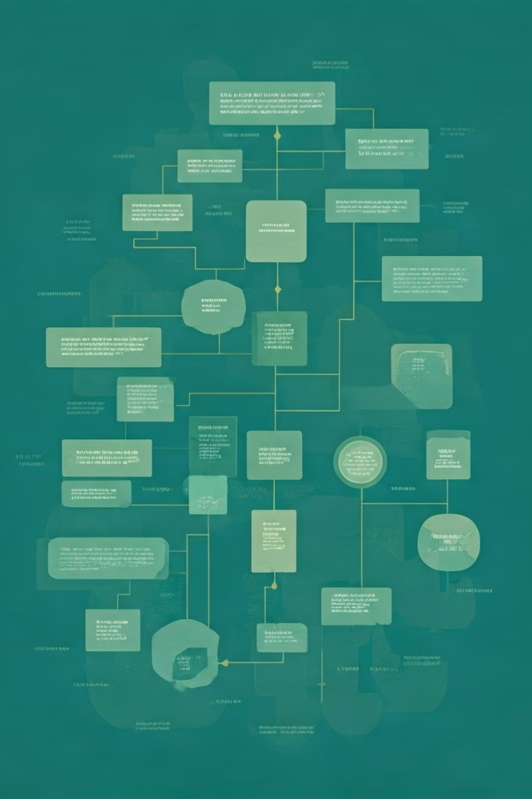




Future Scope
Dynamic Point Sets
Weighted Edges
Consider a scenario where points are added or removed dynamically, requiring efficient updates to the minimum spanning tree.
Explore extensions where edge weights represent different factors, like travel time or data transfer capacity.
3D Space
Real-world Constraints
Extend the problem to three-dimensional space, where points are located in a 3D environment.
Incorporate real-world constraints, such as limited resources, capacity limitations, and geographical restrictions.

Slide 9
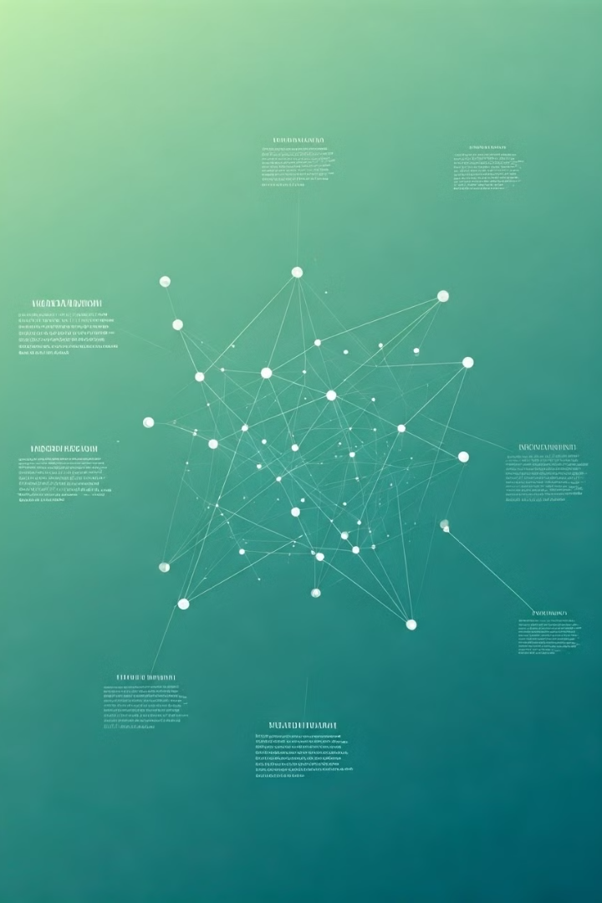
Conclusion
Key Takeaways
Complexity Analysis
Minimum spanning tree algorithms like Kruskal's and Prim's are effective for finding the minimum cost to connect two groups of points.
These algorithms exhibit logarithmic time complexity, making them suitable for efficient solutions.
Future Directions
Future research can explore extensions and variations of the problem, incorporating real-world constraints and complexities.

Slide 10

Thank You
Thank you for your time and interest. We hope this presentation provided a comprehensive overview of the minimum cost connection problem and its various aspects.

